Slide 1
File management
Manish Ranjan Behera

Slide 2
INTRO
The file management in operating system is nothing but software that handles or manages the files present in computer software. The file system in the operating system is capable of managing individual as well as groups of files present in the computer system. The file management in the operating system manages all the files present in the computer system with various extensions (such as .exe, .pdf, .txt, .docx, etc.)
We can also use the file system in the operating system to get details of any files present on our system. The details can be:
location of the file
the owner of the when was the file created
format of the file for example text, pdfs, docs, etc.

Slide 3
File Attributes
Name - The symbolic file name is the only information kept in human- readable form.
Identifier - This unique tag, usually a number identifies the file within the file system.
Type - This information is needed for systems that support different types of files.
Location - This information is a pointer to a device and to the location of the file on that device.
Size - The current size of the file and possibly the maximum allowed size are included in this attribute.
Protection - Access-control information determines who can do reading, writing, executing, and so on.

Slide 4
File Operations
Creating a file
Writing a file
Reading a file
Repositioning within a file
Deleting a file
Truncating a file

Slide 5
Access Methods
Sequential Access - The simplest access method is sequential access. Information in the file is processed in order, one record after the other. This mode of access is by far the most conversion; for example, editors and compilers usually access files in this fashion. Reads and writes make up the bulk of the operations on a file.
Direct Access- Another method is direct access (or relative access). A file is made up of fixed- length logical records that allow programs to read and write records rapidly in no particular order. There are no restrictions on the order of reading or writing for a direct-access file.

Slide 6
DIRECTORY STRUCTURE
A directory is a container that is used to contain folders and files. It organizes files and folders in a hierarchical manner.
Types :
Single-Level Directory

Slide 7
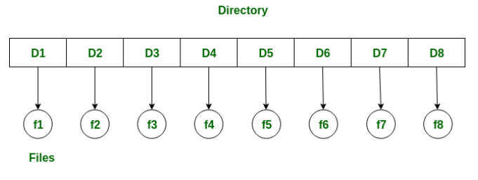
Single-Level Directory
The simplest directory structure is the single-level directory. All files are contained in the same directory, which is easy to support and understand. A single level directory has a significant limitation, however, when the number of files increases or when the system has more than one user. Since all the files are in the same directory, they must have the unique name . if two users call their dataset test, then the unique name rule violated.

Slide 8
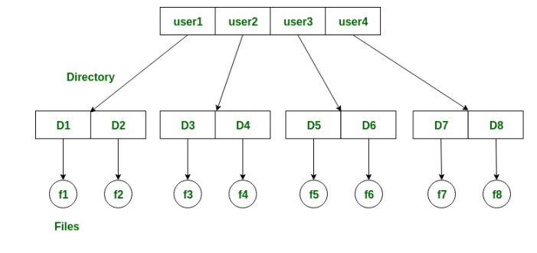
Two-level directory
In a two-level directory structure, there is a master node that has a separate directory for each user. Each user can store the files in that directory. It can be practically thought of as a folder that contains many folders, each for a particular user, and now each user can store files in the allocated directory just like a single level directory.

Slide 9
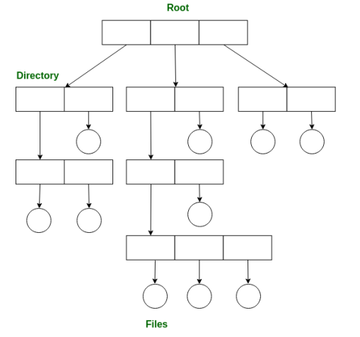
Tree-structured directory
This type of directory is used in our PCs. The biggest disadvantage of a two-level directory was that one could not create sub-directories in a directory. The tree-structured directory solved this problem. In a tree-structured directory, there is a root directory at the peak. The root directory contains directories for each user. The users can, however, create subdirectories inside their directory and also store the files.

Slide 10
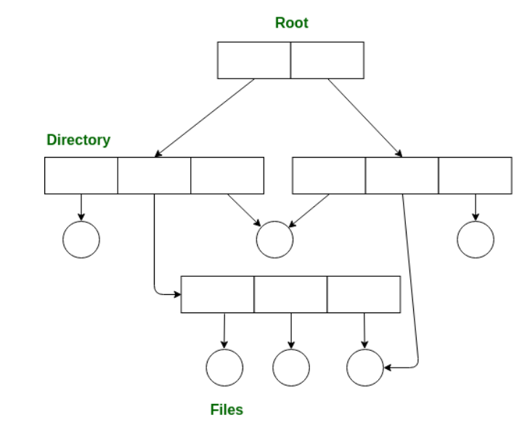
Acyclic graph directory
Suppose there is a file abcd.txt. Out of the other directories, none of them provide the flexibility to access the file abcd.txt from multiple directories. The file can be accessed only by the directory it is present inside.
In this type of directory, we can access a file or a subdirectory from multiple directories. Hence files can be shared between directories. It is designed in such a way that multiple directories point to a particular directory.

Slide 11
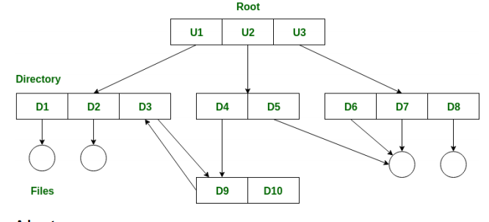
General-graph directory
In general graph directory structure, cycles are allowed within a directory structure where multiple directories can be derived from more than one parent directory. The main problem with this kind of directory structure is to calculate total size or space that has been taken by the files and directories.

